Slide 1
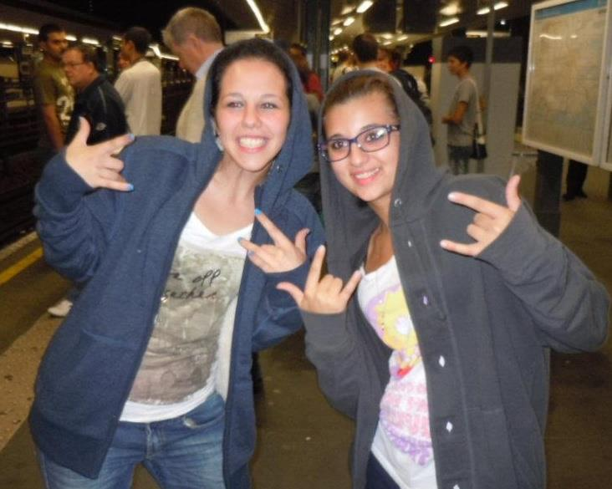
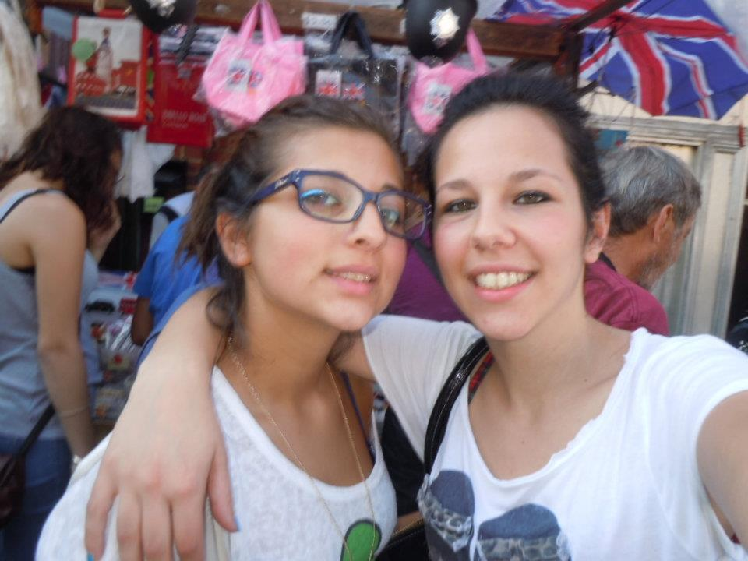
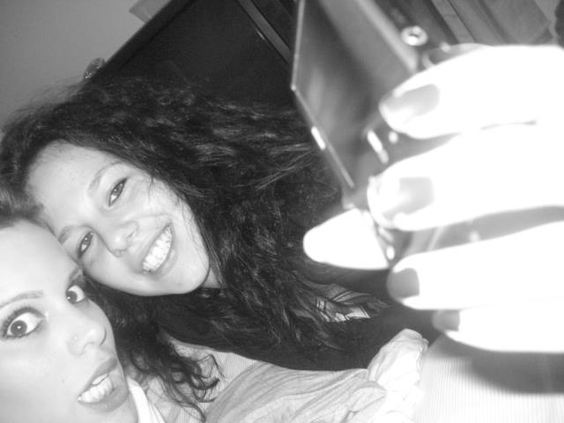
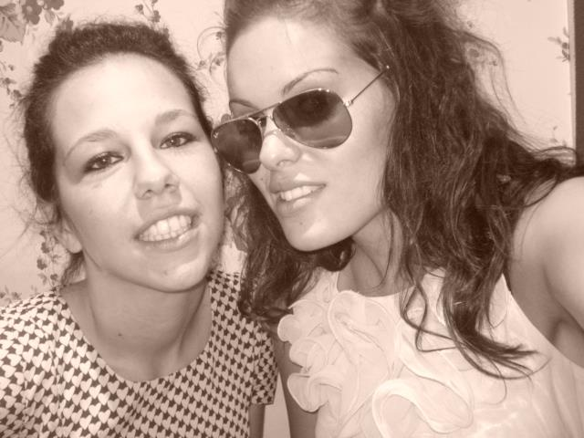
M
A
R
I
A
G
U
A
R
I
N
O
G
I
U
L
I
A

Slide 2
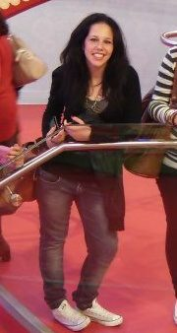
Hi! My name is Maria Giulia. I was born in Rome but now I live in Fano a town on the Adriatic Coast. I’m 19 years old. I attend the last year of high school.
I’m a cheerful girl. I like making new friends and I’m comfortable with all!
I am open to new experiences and I think that this is a good opportunity to get involved.
In my family there are three people: my mother Annalisa, my brother Andrea and I.
We haven’t got any animals because my mother doesn’t like them!
In my free time I like going out with my friends, listening to music and reading!

Slide 3
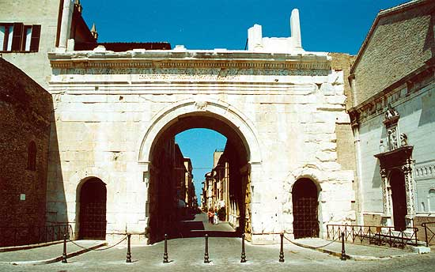
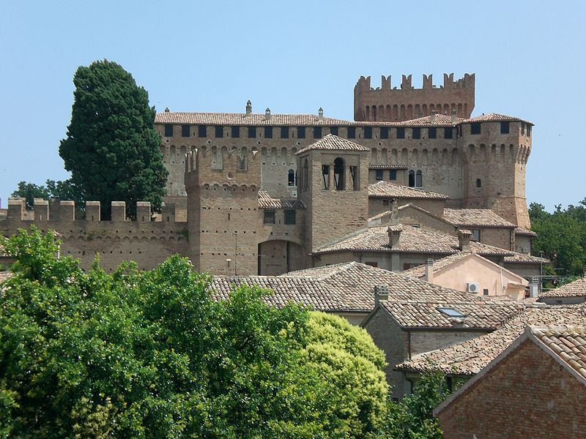
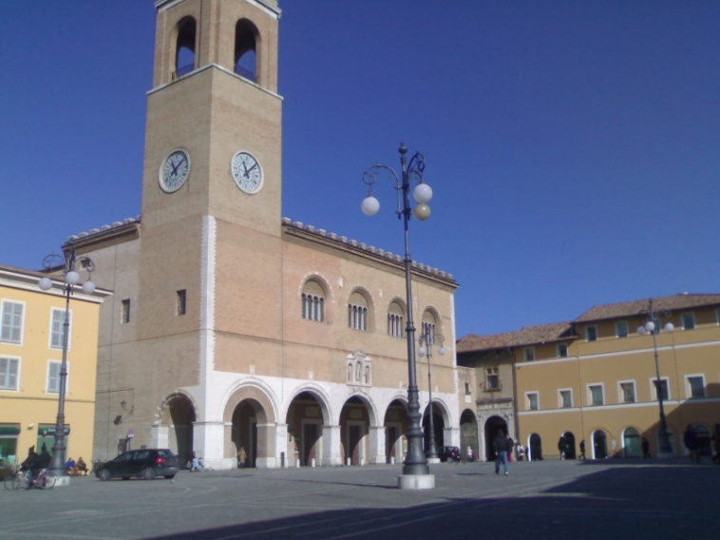
MY
TOWN

Slide 4
MY TOWN
In the past Fano was a Roman possession and was known as 'Fanum Fortunae' the temple of fortune.
History has left us many testimonies of its life.
In the city you can find churches, monuments, fortresses, and you can also find a beautiful theater. to visit!
In the summer the town comes alive .. lying on the sea, the nights are filled with events, exhibitions and markets, and even the warm climate encourages this!!
…my school is located in the heart of the city…

Slide 5
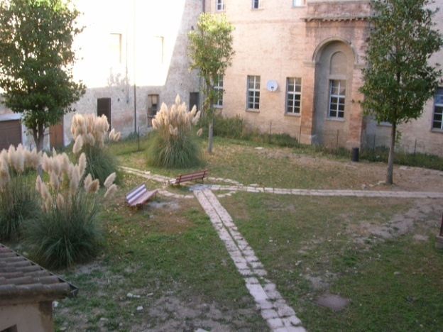
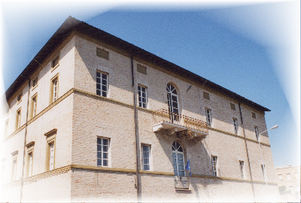
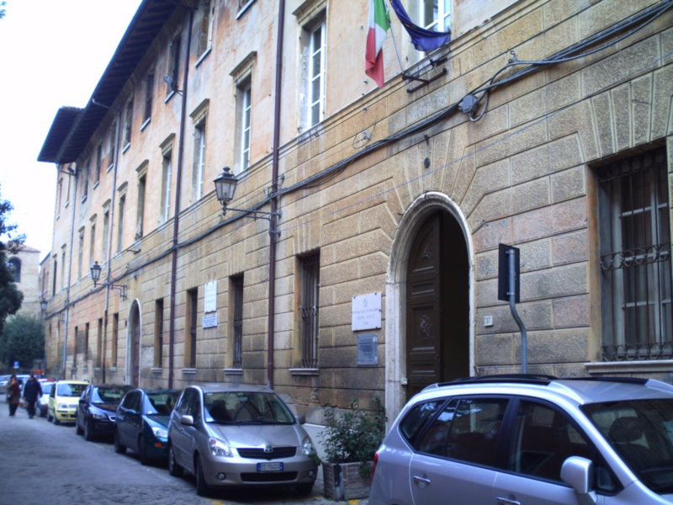
..MY
SCHOOL..

Slide 6



…my school is a vocational school.
It is divided into two branches: the economy, and graphics.
I chose economics and I am attending the last year. I’m waiting for the final exams.
after graduation I will choose whether to go to college or work.

Slide 7
THE SCHOOL SYSTEM

Slide 8
..THE ITALIAN
SCHOOL SYSTEM
WORKS LIKE THIS..

Slide 9
ELEMENTARY SCHOOL
Children go to elementary school from 6 to 11 years.

Slide 10
MIDDLE SCHOOL
From 11 to 13 years students attend the secondary school for a period of 3 years. to be accepted for high school you must pass an exam both oral and written.

Slide 11
HIGH SCHOOL
From 13 to 18 years attend high school, for a period of 5 years. In Italy you can choose between different schools: high schools, art school, vocational school ..
At the end of 5 years are final exams.
After the exams you can choose to continue studying or work.

